Slide 1

Deployment
Technology Solution Center (F. LCS)
.
Simon Wang
2021.06

Slide 2

New Process Deployment
Dynamic table
Mapping MBC & version
Outbound Agreement
Routing code
1
2
3
4
8
7
6
5
Inbound agreement
(run mode 3)
Auto Check
ProcessID
Inbound agreement
(run mode 0)
Write SUPPINFO email whatever Test or Prod.

Slide 3
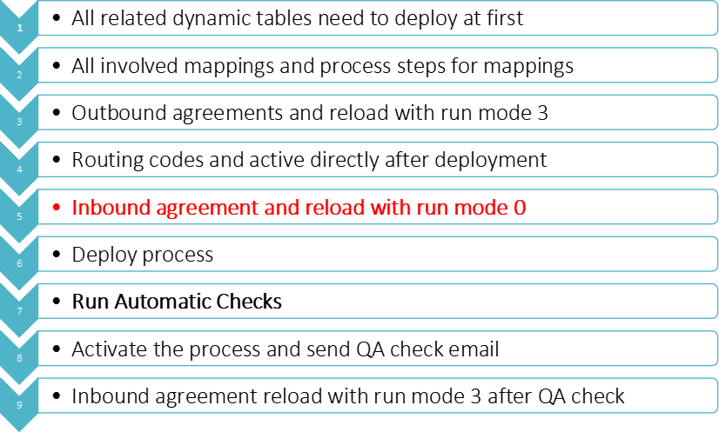
New Process Deployment

Slide 4
Rules of New Process Deploy to Prod
Deployments or changes on Production environment should never be done on a Friday, before public holiday or any other absence
All changes in production must be done before 3pm local time
Stay online for a minimum of 2 hours after deployment or wait still the first file process successfully.
The developer is responsible for process after deployment and activation for 14 days.
If we need to deploy Crop process to prod after 3pm, we need to do handover to ESSN 3rd support
All deployment to prod need to send SUPPINFO email

Slide 5
Important Points about Changes
All changes need to do in DEV and then deploy to corresponding environment.
Process, Routing code need to create new level
Agreement cannot create new level when we do a change, we need to do the change in current level. You can backup the agreement with a new name in DEV before change.
If the “System” is changed about the updated agreement, we need to stop the old agreement(reload with run mode 0) in corresponding environment and remove the agreement folder from COM server at first and then to deploy and reload the updated agreement.
We need to analyze the orders about deploying the updated components.(ensure that it cannot make data error when deployment)

Slide 6
Important Points about Changes
If the requirement need to change another region process or routing code and so on, we need ask coordinator to contact the related region coordinator to apply change request.
If we need to disable and delete something in Test or Prod, we only need to do it in corresponding environment. we cannot delete it from DEV.
All confirmed information which is different with documentation, we need to ask coordinator help to update it into documentation.
Take care and double confirm if we need to change the public routing code and agreement.

Slide 7


Thanks for your attention

